Slide 1
Samples and Sampling in
Clinical Chemistry

Slide 2
Some Important Notes
Proper collection, processing, and storage of samples are critical.
Many errors (preanalytical) can occur during these steps and contribute to delayed and suboptimal patient care.
Preanalytical variables:
  Controllable, Uncontrollable
Controllable variables:
  Collection, Transport, Processing of specimens
Uncontrollable variables are those associated with the physiology of the particular patient (age, sex, underlying disease, etc).

Slide 3
Specimen Collection
Biological specimens in clinical laboratories:
  Whole blood; serum; plasma; urine; feces; saliva; fluids (spinal, synovial, amniotic, pleural, pericardial, and ascitic); and solid tissue.
The Clinical and Laboratory Standards Institute (CLSI), formerly known as the National Committee for Clinical Laboratory Standards or (NCCLS), has published several procedures for collecting many of the most common specimen types under standardized conditions.

Slide 4
Blood
Phlebotomy, the process of collecting a blood sample, is performed from veins, arteries, or capillaries.
Venous blood obtained by venipuncture is usually the specimen of choice.
In young children and for many point-of-care tests, skin puncture is frequently used to obtain what is mostly capillary blood.
Arterial puncture is used mainly for blood gas analyses.

Slide 5
Venipuncture, Preliminary Steps
Confirming the identity of the patient by writing down name, medical record number, date of birth, address, or even medicolegal importance considerations.
In a study of misidentifications: pre: 72.5%, analytical: 20.3%, post: 7.1%
Food intake: fasting vs non-fasting samples, the content of food, the season and dietary habits.
The drugs administered or taken by patient
Other factors such as exercise, surgery, trauma.

Slide 6
Venipuncture, Preliminary Steps
The patient should be asked about latex allergies by latex gloves or a latex tourniquet.
Wearing proper protective equipment, such as a gown, gloves, and in some cases face mask and goggles
⬄⬄⬄ the extent of the precautions required will vary with the nature of a patient’s illness, the institution’s policies, blood borne pathogen plan

Slide 7
Venipuncture, Preliminary Steps
Before sampling, the patient should be comfortable: seated or supine (lying face upward) for as long as possible.
  Stress: ACTH, cortisol, PRL, GH, catecholamines
  Posture: blood homeostasis, the Vol. of blood in standing is 600-700 ml less than lay-down, aldosterone, renine, proteins and ….
Venipuncture should never be performed on a standing patient.
The patient’s arms should be extended in a straight line from the shoulder to the wrist.

Slide 8
Venipuncture, Preliminary Steps
Arms with an inserted IV line, with extensive scarring, or a hematoma at the collection site should be avoided.
If a woman has had a mastectomy, arm veins on that side of the body should not be used because the surgery may have caused lymphostasis, affecting the blood composition.
If the surgery was done within 6 months on both sides, a vein on the back of the hand or at the ankle should be used.
Verifying the tests requested, estimate the Vol. of blood to be drawn.

Slide 9
Venipuncture, Preliminary Steps
Select the appropriate # and types of tubes and needle.
Glass tubes may release trace elements.
The gel in plastic tube may interfere with some trace elemets and tricyclic drugs such as antidepressants
Evacuated blood tubes are usually made of special plastic and this decreases the likelihood of breakage and hence exposure to infectious materials.

Slide 10
Venipuncture, Preliminary Steps
The usual choice for an adult with normal veins is gauge 20.
For volumes of 30-50 ml, an 18-gauge needle may be required to ensure adequate blood flow.
⬄⬄⬄ The larger the gauge, the smaller the bore
⬄⬄⬄ The smaller the bore, the lesser the hemolysis
In some cases winged or butterfly collection set are also used.
Where blood is drawn for trace element measurements, the needle should be stainless steel and known to be free from contamination.

Slide 11
Location
Due to the size and the closeness to the surface of the skin, the median cubital vein in the antecubital fossa, or crook of the elbow, is the preferred site of venipuncture in adults.
Veins on the back of the hand or at the ankle may be used, although these are less desirable and should be avoided in diabetics and other individuals with poor circulation.
In the hospitalized patients, it is appropriate to collect blood through a cannula that is being inserted for long-term fluid infusions at the time of first insertion to prevent a second stick.

Slide 12
Location
If fluid is being infused intravenously into a limb, the fluid should be shut off for 3 min before a specimen is obtained and a suitable note made in the patient’s chart.
The first 5 to 10 mL of blood collected should be discarded.
Specimens obtained from the opposite arm or below the infusion site in the same arm are satisfactory for most tests because of not occurrence of retrograde blood flow.

Slide 13
Preparation of the Site
The area around the puncture site should be cleaned by 3 commonly used materials, prepackaged alcohol swab, gauze pad saturated with 70% isopropanol, or benzalkonium chloride solution (1:750), especially when specimens are to be collected for ethanol determinations.
⬄⬄⬄Povidone-iodine should be avoided because it may interfere with several chemistry procedures.
Cleaning should be done with a circular motion and from the site outward.
The skin should be allowed to dry in the air, traces may cause hemolysis and invalidate test results.
Once the skin has been cleaned, it should not be touched.

Slide 14
Timing
The time at which a specimen is obtained is important for those blood constituents that undergo marked diurnal variation (e.g., PRL. GH, corticosteroids and iron), catamenial variation such as analytes vary in ovary cycl and for those used to monitor drug therapy or for drug measurements in association with medicolegal considerations.

Slide 15
Venous Occlusion
Apply either a blood pressure cuff, inflated to ~60 mm Hg or a tourniquet 10-15 cm above the puncture site.
Venous occlusion must be applied as short-time as possible; slight changes in the composition of blood occur within 1 minute and marked changes have been observed after 3 minutes.
With venous stasis, water and small molecules are absorbed back into the cells
This is concentrating the nondissolved materials, such as proteins and protein-bound constituents.

Slide 16
Venous Occlusion
The composition of the first-drawn, which is most representative of the composition of circulating blood, should be used for those analytes, such as Ca, that are critical in medical decisions.
Later-drawn specimen shows a greater effect from venous stasis.
Thus, the 1st tube may show a 5% increase of [Pr], whereas the 3rd tube may show a 10% change.
Prolonged stasis increases the [protein-bound constituents] by as much as 15%.
Pumping of the fist before venipuncture should be avoided, because it causes an increase in plasma [] of K, phosphate, and lactate.
The lowered blood pH by accumulated lactate ↑ the [Ca²⁺].

Slide 17
Blood Collection with Syringe
The syringe and needle should be aligned with the vein and the vein-needle angle should to be ~15°.
When the initial resistance of the vein wall is overcome as it is pierced, forward pressure on the syringe is eased, and the blood is withdrawn by gently pulling back the plunger of the syringe.
The drawn blood should be quickly but gently transferred into tubes without needle and promptly analyzed in the case of blood gases and in the case of anticoagulation-treated samples, the tubes should be capped and gently mixed.

Slide 18
Completion of Collection
Vigorous withdrawal of blood into a syringe or forceful transfer to the receiving vessel may cause hemolysis of blood.
After withdrawing the needle, the patient is instructed to hold a dry gauze pad over the puncture site, with the arm raised to lessen the likelihood of leakage of blood.
A new pad is subsequently held in place by a bandage, which is removed after 15 minutes.
All tubes should then be labeled, it is seldom acceptable to prelabel.
  Direct labeling of a capillary blood tube by folding the label like a flag around the tube is preferred.
  The blood transfusion case

Slide 19
Completion of Collection
For any specimen submitted in a screwcap test tube or cup, the label should be placed on the cup or tube directly, not to the cap.
No specific labeling should be attached to specimens from patients with infectious diseases to suggest that these specimens should be handled with special care.
All specimens should be treated as if they are potentially infectious.
Depending upon institutional policy, hands should be washed with soap and water or alcohol-based hand cleanser before applying new gloves and proceeding to the next patient.

Slide 20
Skin Puncture
It is used in situations such as limited sample Vol, severe vein damage, due to repeated venipunctures, burned or bandaged patients, and in a point-of-care testing situation
Skin puncture is an open collection technique.
The skin is punctured by a lancet.
The most often used sites: the tip of a finger, an earlobe, the heel or big toe of infants
⬄⬄⬄ Not proper for ambulatory patients from anywhere on the foot

Slide 21
Skin Puncture
To avoid contact with bone, the depth of the incision <2.5 mm
The finger should be held in such a way that gravity assists the collection of blood and the lancet held to make the incision as close to perpendicular to the finger nail as possible.
Avoiding massage of the site, to improve circulation of the blood, the puncture site may be warmed for 3 minutes.
The 1st drop is wiped off, and subsequent drops are transferred to the sample tube or capillary blood tube by gentle contact.
Drop-by-drop collection increases hemolysis.

Slide 22
Arterial Puncture
Arterial punctures require considerable skill and are usually performed only by physicians or specially trained technicians or nurses.
Arterial samples are used primarily for blood gas analysis.

Slide 23
Anticoagulants and Preservatives
Why whole blood or plasma?
  Its needed for some analytes such as blood gases, HbA1C, immunosuppressive drugs (cyclosporine, …)
  The time limitation
  In some delicate samples
Plasma vs serum?
A number of available anticoagulants: Heparin, EDTA, Acid citrate dextrose (ACD), Citrate, Oxalate , Sodium fluoride, and Iodoacetate

Slide 24
Heparin
Heparin, the most widely used anticoagulant for chemistry and hematology testing, is unacceptable for PCR because inhibits the polymerase enzyme.
Heparin inhibits ACP activity.
It interferes with the binding of T3, T4 to their carrier proteins producing higher [FT3 or FT4].
It interferes with the binding of calcium to EDTA.
Heparin is used as lithium salt.
A case

Slide 25
EDTA, Oxalate
EDTA:
As a chelating agent of divalent cations such as Ca²⁺ and Mg²⁺, it is useful for isolation of genomic DNA by preserving the cellular components of blood.
EDTA dipotassium or tripotassium salts are more soluble.
It is effective at a final concentration of 1-2 g/L of blood.
⬄⬄⬄ Higher concentrations hypertonically shrink the RBCs.
Oxalate:
It inhibits coagulation by forming insoluble complexes with Ca²⁺.
Potassium oxalate is used at a concentration of 1-2 g/L of blood.
It causes loss of cell water, thereby diluting the plasma.

Slide 26
Citrate, ACD
Sodium citrate:
Sodium citrate is widely used for coagulation studies because the effect is easily reversible by addition of Ca²⁺.
Because it chelates calcium, it is unsuitable for specimens intended for measurement of calcium.
ACD:
Samples for molecular diagnostics are often collected into this anticoagulant to preserve both the form and function of the cellular components.

Slide 27
Fluoride, Iodoacetate
Sodium fluoride:
Sodium fluoride is a weak anticoagulant through binding divalent metals such as Ca²⁺.
It is often added as a preservative for glucose in blood by inhibiting enolase in glycolysis.
It interferes with urea measurement through inhibition of the urease enzyme.
Sodium iodoacetate:
Sodium iodoacetate is an effective antiglycolytic agent and a substitute for sodium fluoride, because it has no effect on urease.
It has little effect on most clinical tests.

Slide 28
Collection Site & Blood Composition
Skin puncture blood is more like arterial blood than venous blood.
There are no clinically significant differences between capillary blood and arterial blood in pH, PCO₂, and PO₂.
The PCO₂ of venous blood is 6-7 mm Hg higher than that in artery.
Venous blood glucose is as much as 7 mg/dL less than the capillary blood glucose as a result of tissue metabolism.

Slide 29
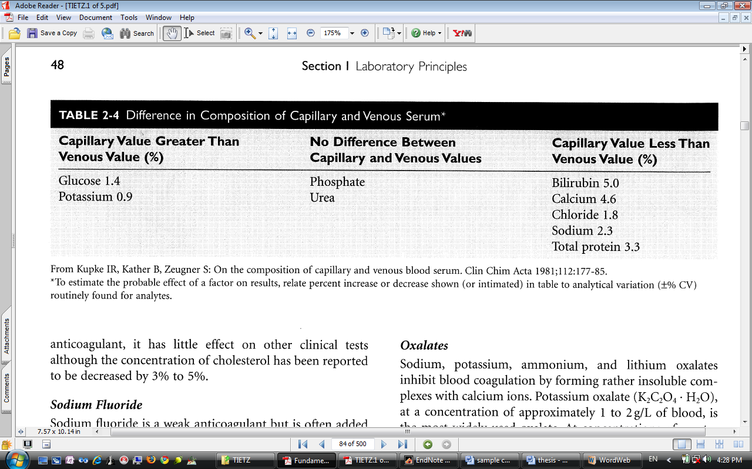
Collection Site & Blood Composition
Blood obtained by skin puncture is contaminated with interstitial and intracellular fluids resulting in increased glucose and potassium and decreased bilirubin, calcium, chloride, sodium, and total protein compared to venous blood.

Slide 30
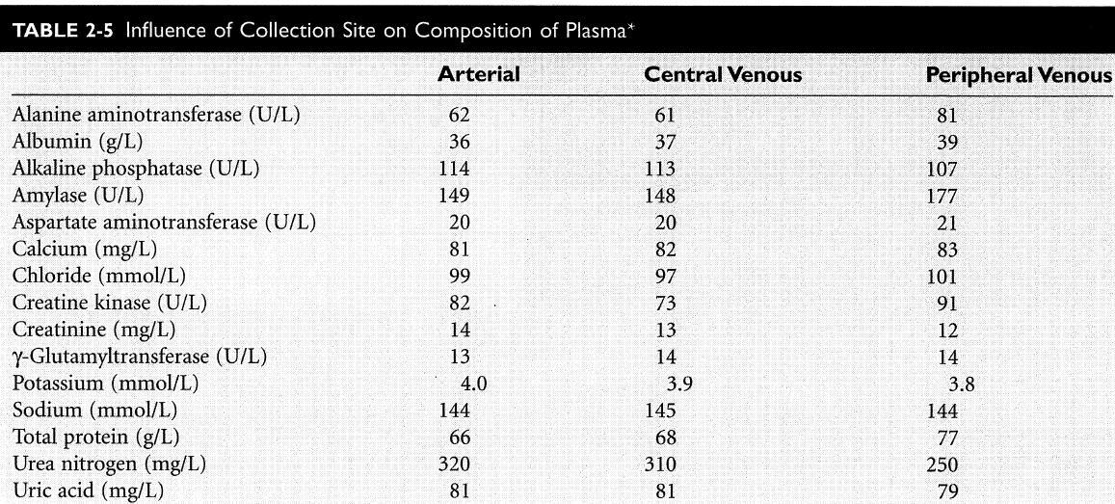
Collection Site & Blood Composition

Slide 31
Hemolysis
Serum shows visual evidence of hemolysis in [Hb] >20 mg/dL.
Severe hemolysis causes dilutional effect on those constituents present at a lower [] in the erythrocytes than in plasma.
However, a notable effect may be observed on those constituents that are present at a higher [] in erythrocytes than in plasma, such as LD, potassium, magnesium, and phosphate.
Hb may cause spectral or chemical interference in chemistry tests.
⬄⬄⬄ In special cases, such as in a patient undergoing chemotherapy cells are fragile.

Slide 32
Processing Specimens and Transit
Centrifugation: after 20 min, 1000-2000 RCF, 10 min
Plasma or serum should be separated as soon as possible and optimally <2 hours, however, premature separation may permit continued formation of fibrin and lead to obstruction of sample probes in testing equipment.
Why? Glc is reduced; blood gas variations and the effects on Ca²⁺.

Slide 33
Processing Specimens and Transit
Specimen tubes should be centrifuged with stoppers in place to:
  Reduce evaporation particularly of volatiles, such as ethanol
  Prevent aerosolization of infectious particles
  Maintain anaerobic conditions, which is important in the measurement of CO₂ and Ca ²⁺
For some tests, specimens must be kept at 4 °C; even, for some thermally labile specimens, serum and plasma should be separated from cells in a refrigerated centrifuge.

Slide 34
Processing Specimens and Transit
In otherwise, the specimen should be held at room temperature rather than at 4°C to decrease hemolysis.
For many labile analytes, such as hormones, the plasma or serum should be frozen immediately.
Repeated freeze-thaw cycles may degrade the analyte.
Light-sensitive specimens including those for bilirubin, methotrexate, carotene, and … must be protected from both daylight and fluorescent light to prevent photodegradation.

Slide 35
Urine Specimens
Usually, urine specimens are collected as:
  Early morning fasting specimens, the most concentrated specimens, are preferred for microscopic examinations and for the detection of abnormal amounts of constituents, such as proteins, or of unusual compounds, such as hCG.
  Untimed or random specimens suitable for only a few chemical tests
  Timed specimens, such as 24-hour urine specimens
The urine should be freshly collected into a clean, dry container with a tight-fitting cover.

Slide 36
Urine Specimen
It must be analyzed within 1 hour of collection if held at room temperature or else refrigerated at 2°C to 8°C for not more than 8 hours before analysis.
If not assayed within these time limits, several changes will occur; bacterial multiplication will cause false-positive nitrite tests, and urease-producing organisms will degrade urea to ammonia and alkalinize the pH.
Loss of CO₂ by diffusion into the air adds to this pH elevation, which, in turn, causes cast degeneration and red cell lysis.

Slide 37
Urine Specimens
For timed specimens, the collection period should be long enough in duration to minimize the influence of short-term biological variations.
In this kind of sampling, the bladder must be emptied when the collection starts and thereafter all urine must be collected until the end of the scheduled time.
The container should be stored in a refrigerator during the collection period.

Slide 38
Urine Specimens
Urine should not be collected at the same time for 2 or more tests requiring different preservatives.
Aliquots for analysis such as microscopic examination or molecular testing should not be removed.
Removal of aliquots is not permissible while a timed collection is in process even when the volume removed is measured and corrected because the excretion of most compounds varies throughout the day.

Slide 39
Urine Specimens
For bacterial examination, the 1st 10 mL of urine voided is most appropriate to detect urethritis.
The midstream specimen is best for investigating bladder disorders.
The double-voided specimen or timed specimen is used to assess, in some metabolic disorders, a metabolite.
Although tests in the clinical chemistry laboratory are not usually affected by lack of sterile collection procedures, the patient’s genitalia should be cleaned before each voiding to minimize the transfer of surface bacteria to the urine.

Slide 40
Collection of Urine from Children
To collect an untimed-urine specimen from a child, the penis and scrotal or perineal area is first cleaned and dried, to remove any dirties.
A plastic bag (U-bag) is placed around the infant’s genitalia and left in place until urine has been voided.
A metabolic bed is used to collect timed specimens from infants.

Slide 41
Urine Preservatives
Preservatives are used to:
  Reduce bacterial action
  Reduce chemical decomposition
  Solubilize constituents that might precipitate out of solution.
Refrigeration is one of the most satisfactory preservation.
Acidification to below pH 3 is widely used to preserve 24-hour specimens and is particularly useful for specimens for calcium, steroids, and VMA determinations.

Slide 42
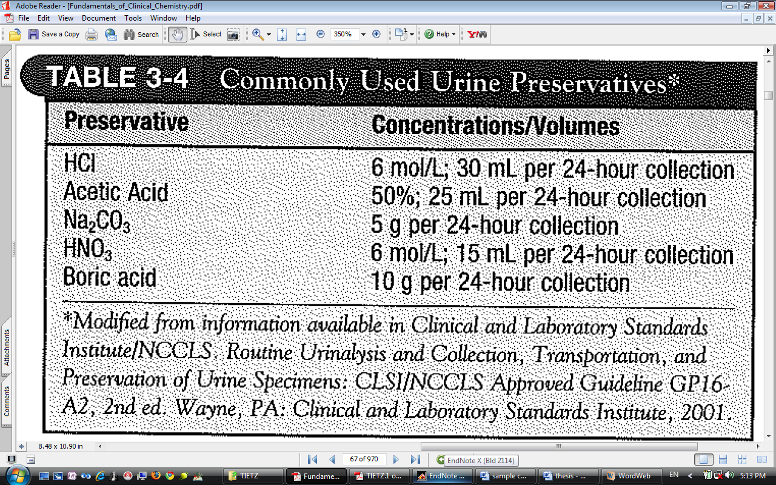
Urine Preservatives
Alkalization of the pH to ~9 is used to preserve specimens for porphyrins, urobilinogen, and uric acid testing.
It must be thoroughly mixed to ensure homogeneity because the composition of the urine will vary throughout the collection period.

Slide 43
Feces
Feces are most commonly tested for microorganisms as the cause of diarrhea and for heme as an indicator of a bleeding ulcer or malignant disease in the GIT.
In children, it may be screened to detect cystic fibrosis.
In adults, fecal excretion of nitrogen and fat is used to assess the severity of malabsorption.
The measurement of fecal porphyrins is occasionally required to characterize the type of porphyria.
Usually, no preservative is used, but the refrigeration is recommended.

Slide 44
Cerebrospinal Fluid (CSF)
CSF is obtained from the lumbar region by a physician in sterile tubes.
It is examined in conditions, such as cerebrovascular accident, meningitis, demyelinating disease, or malignant disease involving meninge.
Because the initial specimen may be contaminated by tissue debris or skin bacteria, the 1st tube should be used for chemical or serological tests, the 2nd for microbiological tests, and the 3rd for cytological examination.

Slide 45
Synovial Fluid, Amniotic Fluid
Synovial Fluid
After arthrocentesis by a physician, it is used to characterize the type of arthritis and to differentiate noninflammatory effusions from inflammatory fluids.
⬄⬄⬄Normally, a very small amount of fluid is present in any joint and an EDTA tube is necessary for cytologic purposes.
Amniotic Fluid
The amniocentesis is performed by a physician.
It is used for prenatal diagnosis of congenital disorders, to assess fetal maturity (by determination of the lecithin-sphingomyelin (L/S) ratio or albumin-surfactant ratio), Rh isoimmunization, and intrauterine infection.

Slide 46
Pleural, Pericardial, and Ascitic Fluids
Collectively, the collection procedure is called paracentesis; however, each procedure has it own name; thoracentesis and pericardiocentesis are used for sampling from the pleural cavity and pericardial cavity, respectively.
The pleural, pericardial, and peritoneal cavities normally contain a small amount of serous fluid that lubricates the opposing parietal and visceral membrane surfaces.
Inflammations or infections accumulate fluid in these cavities.
So, the fluid is examined t determine if it is an effusion or an exudate.

